Slide 1
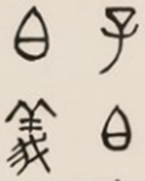
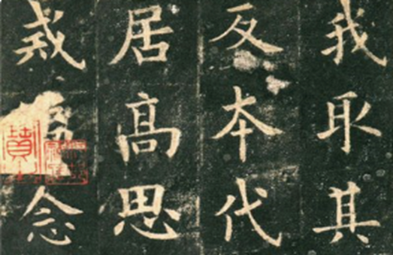
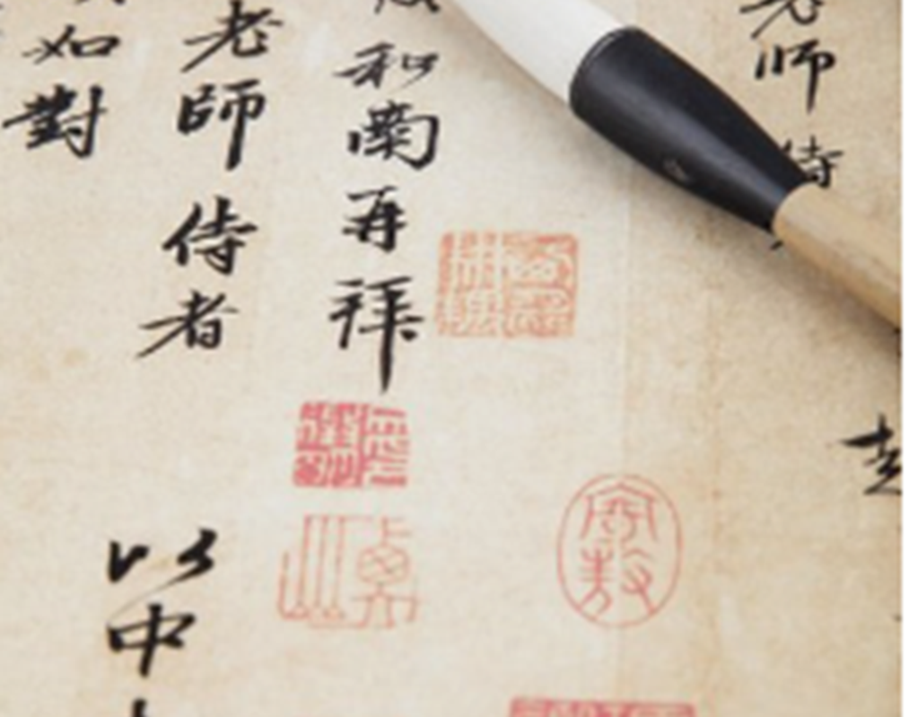
Calligraphy ——The Art of Traditional Chinese Culture
Wu Bingying
Institute&Class

Slide 2
Symbolic Art
4D art based on Chinese characters and written with brush
The law of "unity of opposites"
Reflection of the spirit, temperament, knowledge and accomplishment

Slide 3
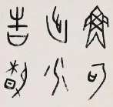
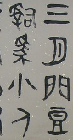
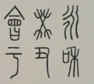
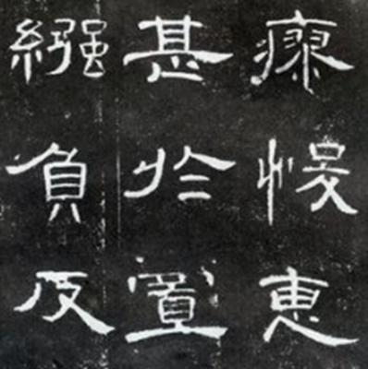
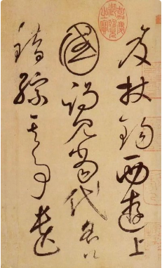
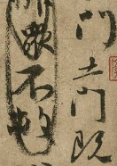
Historical Evolution

Slide 4
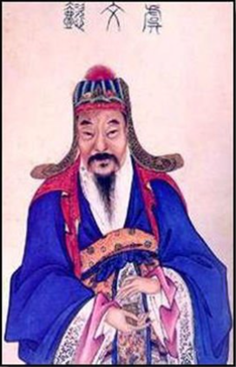
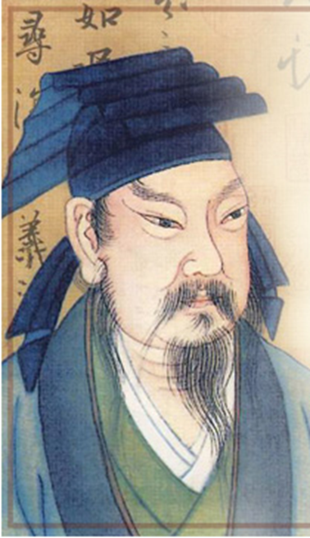
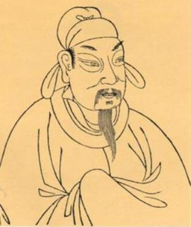
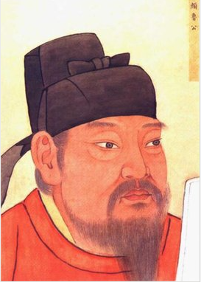
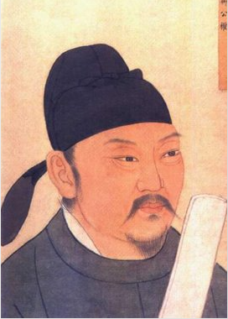
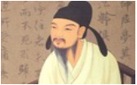
Representative Calligrapher

Slide 5
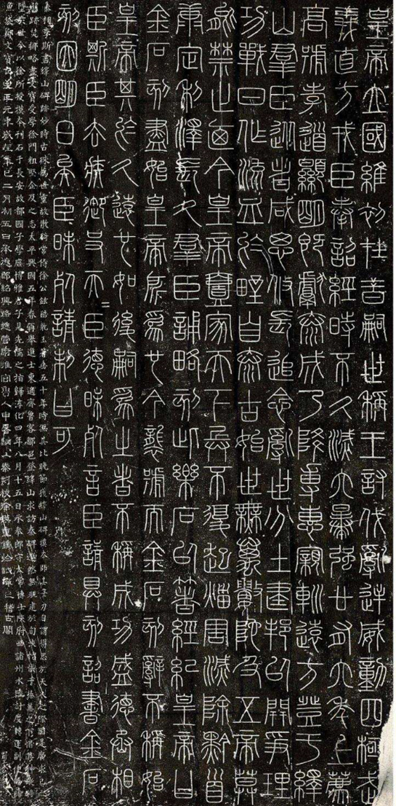
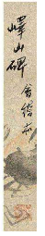

Yishan Stele
This is what I’m practicing now which named YiShanBei,a rubbing from a stone inscription(usu.as a model for calligraphy).
Every time,when I read this rubbing , practice this rubbing and cogitate this rubbing,I find that I’m intoxicated.
All in all,I’m crazy about calligraphy.
As far as I’m concerned,Calligraphy is one of the splendid Chinese treasures.
I sincerely hope that everybody here could get its beauty one day and then join the tream of us,who are fond of the calligraphy!!!

Slide 6

That is all.
Thank you!!!

